Slide 1

Madhav Institute Of Technology And Science
Centre For Artificial Intelligence
Image Classification Using Vision Transformer
Minor Project Presentation (270506)
Submitted By :- Krishna Sharma
Shiv Shrivastava
Submitted To :- Prof. Arun Kumar
Prof. Geetika Hazra

Slide 2
CONTENTS
01
Introduction
02
Vision Transformer
03
Visualization & Patch Formation
04
Flow Chart
05
06
Result
Advantages
07
08
Limitations
Applications

Slide 3
01
Introduction

Slide 4
Dataset
CIFAR - 100 Dataset
ADD YOUR TITLE
Custom Millets Dataset
ADD YOUR TITLE
ADD YOUR TITLE
Origin: Keras Library
Geographic Origin: Varied, synthetically generated dataset
Characteristics: CIFAR-100 is a well-known dataset containing 100 classes, each with 600 images, covering a broad spectrum of object categories. The dataset is designed to challenge image classification models with diverse and complex visual concepts.
Origin: In-house collection
Geographic Origin: Taken from various locations from the city.
Characteristics: This custom dataset is curated specifically for millets plant species, encompassing multiple varieties and conditions. The dataset includes images capturing various stages of growth and potential diseases affecting millets plants.
This PPT template for the rice husk designer pencil demo works, focusing on the production of high-end design husk designer pencil demo works, focusing on This PPT template for the rice
This PPT template for the rice husk designer pencil demo works, focusing on the production of high-end design husk designer pencil demo works, focusing on This PPT template for the rice
This PPT template for the rice husk designer pencil demo works, focusing on the production of high-end design husk designer pencil demo works, focusing on This PPT template for the rice

Slide 5
Image Classification using Vision Transformer
We are using Vision Transformer to classify any image to a particular label by giving its data in terms of images. Here, we are providing two types of datasets to understand functioning on small as well as large dataset.
Image classification is a task in machine learning where the goal is to assign a label or category to an input image based on its content. This is a fundamental problem in computer vision and has various applications, such as facial recognition, object detection, medical image analysis.
The Vision Transformer, or ViT, is a model for image classification that employs a Transformer-like architecture over patches of the image. An image is split into fixed-size patches, each of them are then linearly embedded, position embeddings are added, and the resulting sequence of vectors is fed to a standard Transformer encoder. In order to perform classification, the standard approach of adding an extra learnable “classification token” to the sequence is used.

Slide 6
02
Vision Transformer

Slide 7
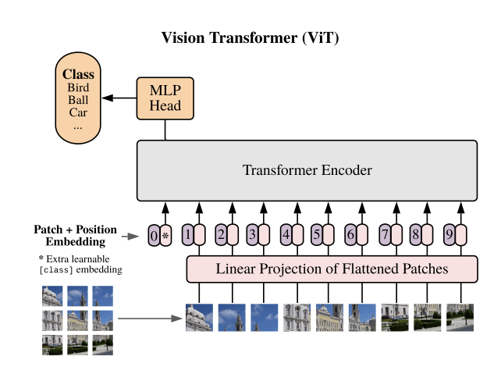
Vision Transformer
The Vision Transformer, introduced by Vaswani et al. in 2017(first research paper on vision transformer), represents a departure from the conventional convolutional neural network (CNN) paradigm. Instead of relying on convolutional layers, the ViT operates on image patches, treating them as sequential inputs to a transformer architecture originally designed for natural language processing tasks.
Radford et al. (2021) demonstrated that ViTs can achieve competitive performance on various image classification benchmarks

Slide 8
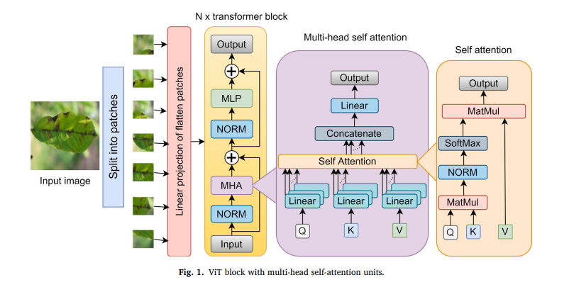
Full Architecture of Vision Transformer

Slide 9
03
Visualization and Patch Formation

Slide 10
Visualization and Patch Formation
In Fig. 2, the schematic representation illustrates the crucial steps of patch visualization and encoding within the Vision Transformer (ViT) framework. The process begins with the selection of a random image from the CIFAR-100 dataset. This image is then resized to a standardized image_size, after which the Patches class is employed to extract non-overlapping patches from the resized image. These patches, illustrated in the diagram, showcase the decomposition of the original image into smaller, distinct components.
This visual representation in Fig. 2 provides a concise overview of the patch visualization and encoding stages, offering insights into the initial processing steps crucial for ViT-based image classification.

Slide 11
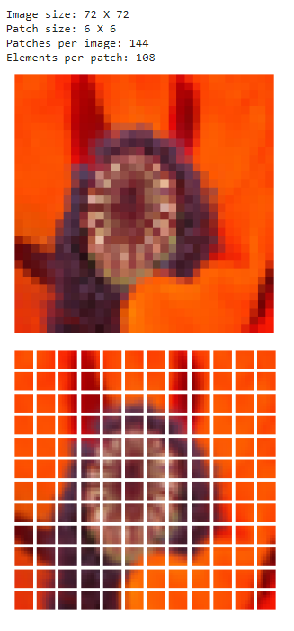
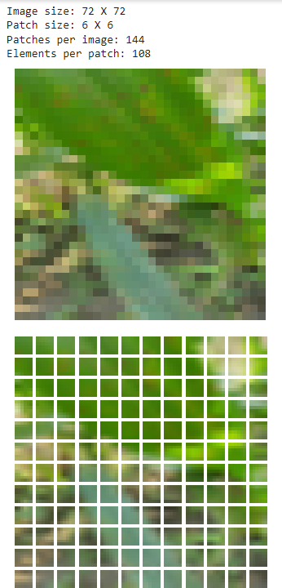
Visualisation and Patch Formation

Slide 12
04
Flow Chart

Slide 13
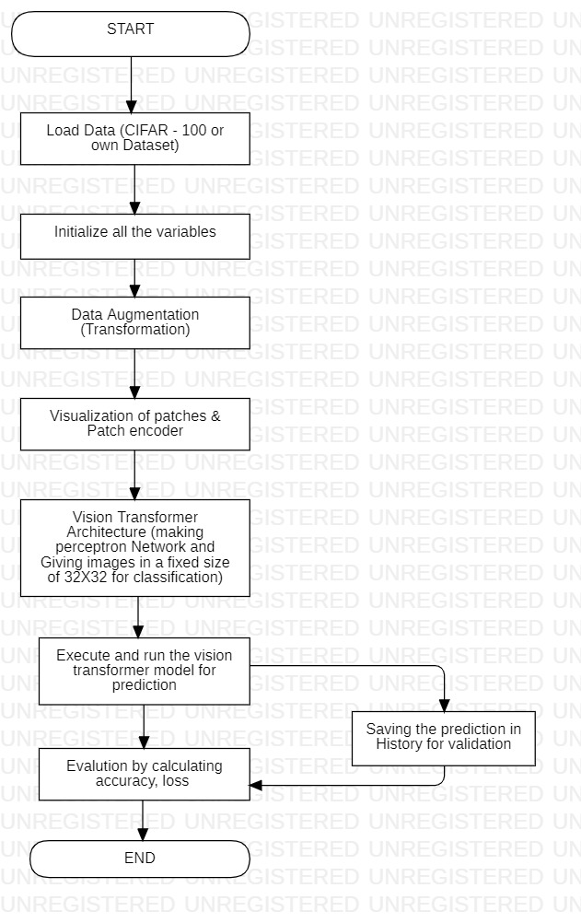
Flow Chart

Slide 14
Thank you
Submitted By :-
Krishna Sharma (0901AD211025)
Shiv Shrivastava (0901AD211057)

